Slide 1
Prototype

Slide 2
Intent
Specify the kinds of objects to create using a prototypical instance, and create new objects by copying this prototype.

Slide 3
Uses of Prototype Pattern
When a client needs to create a set of objects that are alike or differ from each other only in terms of their state and it is expensive to create such objects in terms of the time and the processing involved.
As an alternative to building numerous factories that mirror the classes to be instantiated (as in the Factory Method).

Slide 4
Advantages
avoid subclasses of an object creator in the client application, like the abstract factory pattern does.
avoid the inherent cost of creating a new object in the standard way (e.g., using the 'new' keyword) when it is prohibitively expensive for a given application.

Slide 5
Prototype suggests to
Create one object upfront and designate it as a prototype object.
Create other objects by simply making a copy of the prototype object and making required modifications.

Slide 6
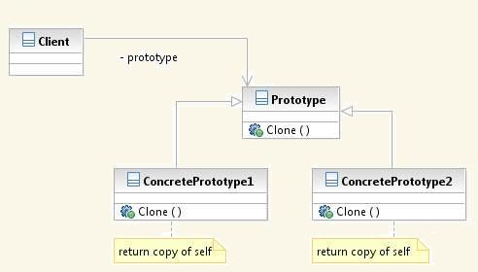
Structure

Slide 7
Participants
Prototype
- Describes an interface for cloning itself
Concrete Prototype
- Implements an operation for cloning itself.
Client
- Creates a new object by asking a prototype to clone itself.

Slide 8
Real world examples
New Software Program Creation — Typically programmers tend to make a copy of an existing program with similar structure and modify it to create new programs.
Cover Letters — When applying for positions at different organizations, an applicant may not create cover letters for each organization individually from scratch. Instead, the applicant would create one cover letter in the most appealing format, make a copy of it and personalize it for every organization.

Slide 9
SHALLOW COPY
The original top-level object and all of its primitive members are duplicated.
Any lower-level objects that the top-level object contains are not duplicated. Only references to these objects are copied. This results in both the original and the cloned object referring to the same copy of the lower-level object.

Slide 10
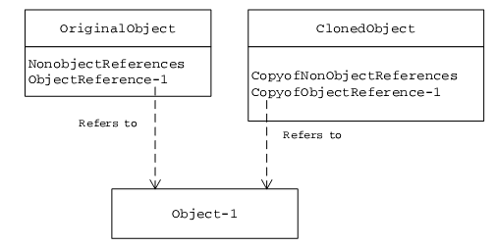
SHALLOW COPY

Slide 11
Code
class Person implements Cloneable {
//Lower-level object
private Car car;
private String name;
public Car getCar() {
return car;
}
public String getName() {
return name;
}
public void setName(String s) {
name = s;
}
public Person(String s, String t) {
name = s;
car = new Car(t);
}

Slide 12
Code
public Object clone() {
//shallow copy
try {
return super.clone();
} catch (CloneNotSupportedException e) {
return null;
}
}
}
class Car {
private String name;
public String getName() {
return name;
}
public void setName(String s) {
name = s;
}
public Car(String s) {
name = s;
} }

Slide 13
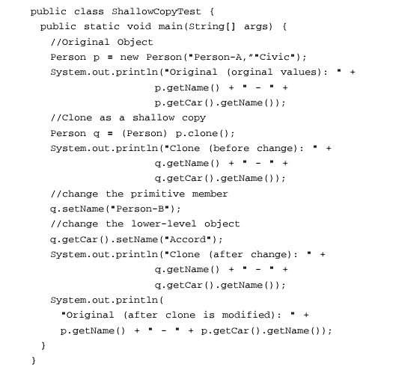
Code

Slide 14

Output

Slide 15
DEEP COPY
The original top-level object and all of its primitive members are duplicated.
Any lower-level objects that the top-level object contains are also duplicated. In this case, both the original and the cloned object refer to two different lower-level objects.

Slide 16
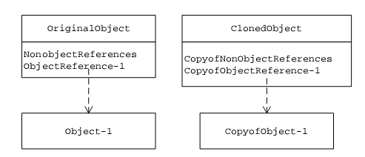
DEEP COPY

Slide 17
Code
class Person implements Cloneable {
//Lower-level object
private Car car;
private String name;
public Car getCar() {
return car;
}
public String getName() {
return name;
}
public void setName(String s) {
name = s;
}
public Person(String s, String t) {
name = s;
car = new Car(t);
}

Slide 18
Code
public Object clone() {
//Deep copy
Person p = new Person(name, car.getName());
return p;
}
}
class Car {
private String name;
public String getName() {
return name;
}
public void setName(String s) {
name = s;
}
public Car(String s) {
name = s;
} }

Slide 19
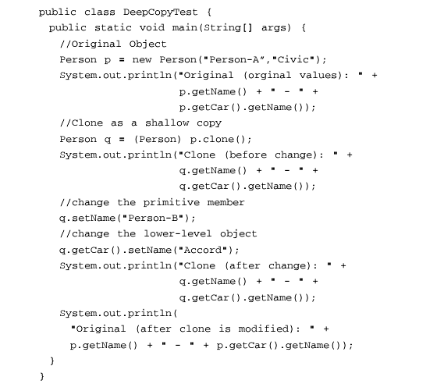
Code

Slide 20

Output

Slide 21
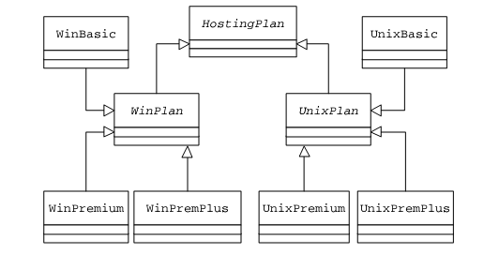
Example I Representation of different hosting packages

Slide 22
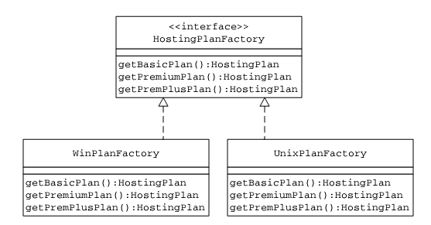
Applying Abstract Factory

Slide 23
Applying Abstract Factory
WinPlanFactory would be responsible for the creation of WinBasic, WinPremium and WinPremiumPlus objects.
UnixPlanFactory would be responsible for the creation of UnixBasic, UnixPremium and UnixPremiumPlus objects.

Slide 24
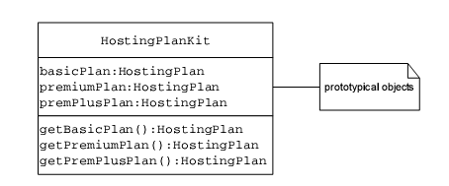
Design Highlights of the HostingPlanKit Class

Slide 25
Design Highlights of the HostingPlanKit Class
public class HostingPlanKit {
private HostingPlan basicPlan;
private HostingPlan premiumPlan;
private HostingPlan premPlusPlan;
public HostingPlanKit(HostingPlan basic, HostingPlan premium,HostingPlan premPlus) {
basicPlan = basic;
premiumPlan = premium;
premPlusPlan = premPlus;
}

Slide 26
Design Highlights of the HostingPlanKit Class
public HostingPlan getBasicPlan() {
return (HostingPlan) basicPlan.clone();
}
public HostingPlan getPremiumPlan() {
return (HostingPlan) premiumPlan.clone();
}
public HostingPlan getPremPlusPlan() {
return (HostingPlan) premPlusPlan.clone();
}
}

Slide 27
Design Highlights of the HostingPlanManager Class
public class HostingPlanManager {
public static HostingPlanKit getHostingPlanKit(String platform) {
HostingPlan basicPlan = null;
HostingPlan premiumPlan = null;
HostingPlan premPlusPlan = null;
if (platform.equalsIgnoreCase("Win")) {
basicPlan = new WinBasic();
premiumPlan = new WinPremium();
premPlusPlan = new WinPremPlus();
}

Slide 28
Design Highlights of the HostingPlanManager Class
if (platform.equalsIgnoreCase("Unix")) {
basicPlan = new UnixBasic();
premiumPlan = new UnixPremium();
premPlusPlan = new UnixPremPlus();
}
return new HostingPlanKit(basicPlan, premiumPlan,premPlusPlan);
}
}

Slide 29
Client
public class TestClient {
public static void main(String[] args) {
HostingPlanManager manager = new HostingPlanManager();
HostingPlanKit kit = manager.getHostingPlanKit("Win");
HostingPlan plan = kit.getBasicPlan();
System.out.println(plan.getFeatures());
plan = kit.getPremiumPlan();
System.out.println(plan.getFeatures());
}
}

Slide 30
Usage
Once the HostingPlanKit object is received, a client can make use of getBasicPlan/ getPremiumPlan/ getPremPlusPlan methods to get access to HostingPlan objects.

Slide 31
Example II
A computer user in an organization is associated with a user account. A user account can be part of one or more groups. Permissions on different resources are defined at group level. A user gets all the permissions defined for all groups that his or her account is part of. Build an application to facilitate the creation of user accounts. Consider two groups – Supervisor and AccountRep.

Slide 32
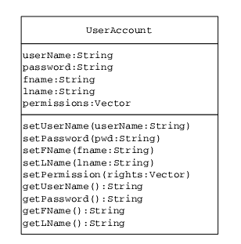

Slide 33
User Account Class
public class UserAccount {
private String userName;
private String password;
private String fname;
private String lname;
private Vector permissions = new Vector();
public void setUserName(String uName) {
userName = uName;
}
public String getUserName() {
return userName;
}

Slide 34
User Account Class
public void setPassword(String pwd) {
password = pwd;
}
public String getPassword() {
return password;
}
public void setFName(String name) {
fname = name;
}
public String getFName() {
return fname;
}

Slide 35
User Account Class
public void setLName(String name) {
lname = name;
}
public String getLName() {
return lname;
}
public void setPermissions(Vector rights) {
permissions = rights;
}
public Vector getPermissions() {
return permissions;
}
}

Slide 36
Simplest way to create an user account
Instantiate the UserAccount class
Read permissions from an appropriate data file
Set these permissions in the UserAccount object

Slide 37
Redesign the UserAccount Class
Designing the UserAccount class to implement the Cloneable interface.
Returning a shallow copy of itself as part of its implementation of the clone method

Slide 38
Revised User Account Class
public class UserAccount implements Cloneable {
private String userName;
private String password;
private String fname;
private String lname;
private Vector permissions = new Vector();
public Object clone() {
//Shallow Copy
try {
return super.clone();
} catch (CloneNotSupportedException e) {
return null;
} } }

Slide 39
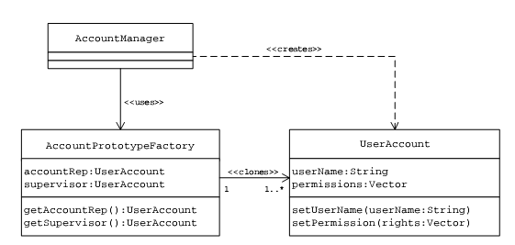
UserAccount Creation Utility: Class Association

Slide 40
Create a Prototype Factory Class
A new class, AccountPrototypeFactory, can be defined to hold prototypical UserAccount objects representing Supervisor and accountRep type accounts.
When requested by a client, the AccountPrototypeFactory returns a copy of an appropriate UserAccount object.

Slide 41
public class AccountPrototypeFactory {
private UserAccount accountRep;
private UserAccount supervisor;
public AccountPrototypeFactory(UserAccount supervisorAccount, UserAccount arep) {
accountRep = arep;
supervisor = supervisorAccount;
}
public UserAccount getAccountRep() {
return (UserAccount) accountRep.clone();
}
public UserAccount getSupervisor() {
return (UserAccount) supervisor.clone();
}
}

Slide 42
Client AccountManager class
public class AccountManager {
public static void main(String[] args) {
Vector supervisorPermissions =
getPermissionsFromFile("supervisor.txt");
UserAccount supervisor = new UserAccount();
supervisor.setPermissions(supervisorPermissions);
Vector accountRepPermissions =
getPermissionsFromFile("accountrep.txt");
UserAccount accountRep = new UserAccount();
accountRep.setPermissions(accountRepPermissions);
AccountPrototypeFactory factory = new AccountPrototypeFactory(supervisor,accountRep);

Slide 43
Client AccountManager class
UserAccount newSupervisor = factory.getSupervisor();
newSupervisor.setUserName("PKuchana");
newSupervisor.setPassword("Everest");
System.out.println(newSupervisor);
UserAccount anotherSupervisor = factory.getSupervisor();
anotherSupervisor.setUserName("SKuchana");
anotherSupervisor.setPassword("Everest");
System.out.println(anotherSupervisor);
UserAccount newAccountRep = factory.getAccountRep();
newAccountRep.setUserName("VKuchana");
newAccountRep.setPassword("Vishal");
System.out.println(newAccountRep); } }

Slide 44
Coding Hints
The client object creates two UserAccount objects representing Supervisor and AccountRep type accounts. These instances are stored inside the AccountPrototypeFactory as prototype objects. This is the only time permissions are read from data files.
Each time a new Supervisor or AccountRep type account needs to be created, the client invokes one of the getSupervisor() or getAccountRep() methods of the AccountPrototypeFactory. The AccountPrototypeFactory clones an appropriate prototype UserAccount object and returns it to the client, which can make necessary changes such as setting the user name and password.

